Slide 1
Terraform

Slide 2
Topics for Presentation -
Infrastructure as a code
Terrafrom overview
Terraform Stages
Pros and Cons of Terraform
State Management in Terraform
Building Blocks of Terraform
Best practices
Demo (Deploy EC2 instance nginx installation and deploy a complex serverless flow with multiple AWS resources)

Slide 3
Overview of IaC(Infrastructure as a code) –
Scripts instead of clicking through console to build/provision AWS, Azure resources in the cloud .
Prevents configuration drift and allows to have governance in place when we deploy resources in the cloud.
Easier to recreate when provisioned resources are destroyed accidently.
Allows us to provision only when required and destroy resources when it’s not needed (outside business hours) to save cost.
All or Nothing.

Slide 4
Terraform
Powerful tool - allows to create, update, and control versioning of cloud infrastructure.
Works on state for execution plan to reach the desired state for building described infrastructure.
Automated infrastructure management, lower deployment costs, and reduced provisioning time.
Supports JSON or HCL (Hashicorp Configuration Language) language.

Slide 5
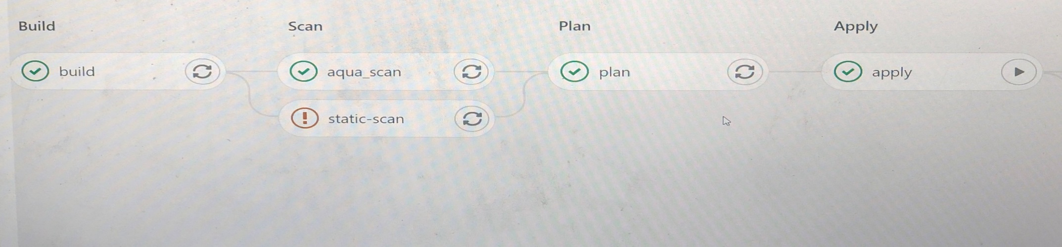
Terraform Stages –
Init
Plan
Apply
Destroy
Additional Commands –
Validate
Fmt

Slide 6
Advantages of Terraform -
More Generic
Client requirement
Repeatability
Dry Runs
Cloud agnostic
Super portability
Disadvantages of Terraform -
New thing to learn
No rollback capability, must be done through version control
Doesn’t have GUI.
Terraform state is the key, if it gets corrupted it can’t be restored.

Slide 7
State Management -
For IaC, we need to keep track of what resources are created/updated/deleted.
.tfstate
Does not get automatically refreshed when new scripts are added for resources/updated.
Building Blocks of Terraform Configuration -
Terraform – Version
Provider
Resources
Outputs
Variables

Slide 8
Terraform and Providers
Each terraform block can contain a number of settings related to Terraform's behavior.
The required_version setting accepts a version constraint string, which specifies which versions of Terraform can be used with your configuration.
AWS –
terraform {
required_providers {
aws = {
version = ">= 2.7.0"
source = "hashicorp/aws"
}
}
}
Terraform Resources -
Each resource block describes one or more infrastructure objects.
Resource Behavior explains in more detail how Terraform handles resource declarations when applying a configuration.
Resource Blocks documents the syntax for declaring resources.

Slide 9
Terraform Output
Output values are like the return values of a Terraform module.
A child module can use outputs to expose a subset of its resource attributes to a parent module.
A root module can use outputs to print certain values in the CLI output after running terraform apply.
Example -
output "instance_ip_addr" {
value = aws_instance.server.private_ip
}
Terraform Variables –
Terraform variables can be defined within the infrastructure plan but are recommended to be stored in their own variables file.
Files in Terraform directory using . tf file format is automatically loaded during operations.
Should be named variables.tf.

Slide 10
Terraform Modules
Container for multiple resources that are used together.
Every Terraform configuration has at least one module, known as its root module.
Module can call other modules.
Modules can be called multiple times.
Terraform Enterpise(TFE) –
Self-hosted distribution of Terraform Cloud
Private instance of the Terraform Cloud application, with no limits.
Allows audit logging and single sign on.
Easy access to shared state.
Private Module Registry.
Cost Estimation
Sentinel - Embedded policy-as-code framework

Slide 11
Best Practices -
Use Variables
Use modules
Use advantage of built in Terraform functions
Backup system state if multiple developers are working.
Keep the scripts in repository.

Slide 12
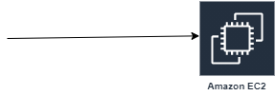
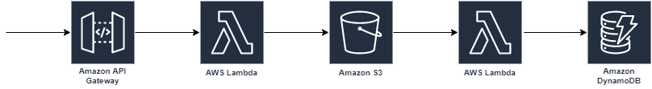
Terraform - Demo
1. Deploy EC2 instance nginx installation
Terraform Script
(IaC)
2. Deploy a complex serverless flow with multiple AWS resources
Terraform Script
(IaC)

Slide 13
Questions..

